Slide 1
Inequality in a Global Perspective
Ravi Kanbur
www.kanbur.dyson.cornell.edu
Southern Centre for Inequality Studies
Annual Inequality Lecture
Johannesburg, 11 August, 2020

Slide 2
Introduction
My focus in this talk will be on economic dimensions of inequality.
My perspective will be primarily global.
I will start by laying out some emerging global patterns of economic inequality.
I will argue that these emerging patterns raise both operational and philosophical questions which were not prominent thirty or forty years ago.
They also raise questions for global constraints on national policy for inequality, and for global coordination of national policy.

Slide 3
Outline
1. Introduction
2. Global Trends in Inequality
3. Implications for Development Assistance
4. Global Constraints on National Policy
5. Conclusion

Slide 4
Global Trends in Inequality
Before discussing trends and patterns of economic inequality around the world, a word on concepts, data, and measurement.
Preliminaries: Inequality of what and Inequality between whom?
What: Economic magnitudes like income or consumption.
Host of technical issues eg price corrections. Big debates.

Slide 5
Whom: Typical practice is to focus on differences in economic magnitudes across individuals.
Again, host of technical issues eg differing needs across individuals. Big debates.
Given the what and the whom, measure of spread or inequality of the what across the whom. Gini coefficient. Mean Log Deviation. Etc. Again big debates.
Similar issues with measurement of poverty. Which cutoff to use to delineate poverty. Big debates at the national level and at the global level. Current international line is $1.90 per person per day in “Purchasing Power Parity” dollars.

Slide 6
All these debates are resolved in some form or fashion by National Statistical Offices and International Organizations to produce the numbers on inequality and poverty we all use.
What, then do these numbers tell us about the global trends of economic inequality?

Slide 7
Rapid rises in inequality in the US, in parts of Europe, and in a range of big Asian countries like China and India have led to a narrative that we are living in “An Age of Rising Inequality.”
For the US and Europe, the work of Piketty (2014) and colleagues is well known.
For Asia, Asian Development Bank (2012) presented data which showed that between the 1990s and the 2000s, inequality had risen in countries comprising no less than 80% of developing Asia’s population.

Slide 8
The most spectacular of these cases is of course China. After its opening up in 1978, and especially after its opening up to world trade from the 1990s onwards, China had dramatic growth and unheard of poverty reduction.
But it also had very sharp increase in inequality. As Kanbur, Wang and Zhang (2017) show, between 1995 and 2010 the Gini coefficient for China rose from 0.35 to 0.53.
All of this has fed into a narrative of “An Age of Rising Inequality.”

Slide 9
But if by an age of rising inequality is meant inequality rising everywhere, or almost everywhere, the claim is easily dismissed.
The leading exhibit for a counter trend is Latin America, once the poster child for high and rising inequality. However, from about the mid-1990s onwards, measured inequality in most Latin American countries fell for the next fifteen years (Lopez-Calva and Lustig, 2010; Gasparini and Lustig, 2012; Lustig, 2014).
But there are counters from elsewhere in the world as well.

Slide 10
Sub-Saharan Africa: “For the subset of 23 countries for which surveys are available with which to assess trends in inequality, half the countries experienced a decline in inequality and the other half saw an increase. No clear patterns are observed by countries’ resource status, income status, or initial level of inequality.” (Beegle et. al., 2016, p 15).
Central Asia and South Caucasus: “the consumption-based Gini indexes show an overall downward trend during 2000–16 for most of CASC countries, with the exception of some upward movements experienced in recent years in Azerbaijan and Tajikistan (Figure 3.3).” (Capanelli and Kanbur, 2019, forthcoming)

Slide 11
Middle East and North Africa: “With the exception of Djibouti in 2012, the 90/10 ratio for most MNA countries appears to hover between 3 and 6 …. In addition, the ratio appears to have declined or stayed the same in all countries except Iraq.” (Krishnan et al, 2016, p. 3).
Even for China the picture is more nuanced than the common narrative. In fact, Kanbur, Wang and Zhang (2017) highlight the fact that from 2010 onwards, there was a plateauing of the Gini coefficient trend.

Slide 12
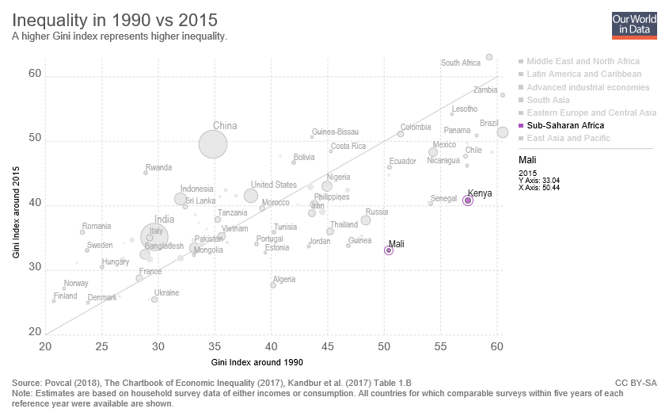

Slide 13
So, the answer to the question “Are We Living in an Age of Rising Inequality?” is clearly NO if by this is meant inequality rising every where or almost everywhere.
But I have argued in my writings that the answer is YES in the sense that the fundamental economic forces of technical change and capital accumulation are aligned to increase inequality on a business as usual scenario.

Slide 14
The role of increasing wealth inequality has been argued by Piketty (2014) and dramatic increase in wealth inequality have been well documented.
But we are also living in an age where the trend of technological progress is to displace basic labor in favor of skilled labor and capital.
Such labor saving technical change, also called skill biased technical change has been the hallmark of the world economy for at least the last three decades, and looks set to continue in the decades to come (Autor, 2014; Acemoglu and Autor, 2011; Acemoglu and Restrepo 2018; Chau and Kanbur 2018).

Slide 15
The displacement effects of these trends work to increase inequality as wages of highly skilled labor (and returns to capital) increase and wages of basic labor fall if there is downward flexibility, or unemployment is created if wages are not flexible.
So there are fundamental economic forces making for rising inequality. Why is inequality then not rising everywhere? The answer is policy. Where policy has countered the forces inequality increase has been mitigated and even countered. (eg policies followed in Latin American countries during their period of inequality reduction).
I will take up policy issues later in this talk.

Slide 16
Up to now I have been discussing trends in inequality within countries. But what about inequality between countries?
Think of a world made up of China and the US. We have seen that inequality within China and within the US has been rising. But China’s average income has been rising at 10% a year for the past three decades, while the US growth rate has barely broken 2% per year.

Slide 17
The US average income is still much higher than China’s. But because of the differential growth rates the gap has been closing. So inequality between the US and China is declining even as inequality within the US and within China has been rising.
This is in fact a global phenomenon. Of course there are exceptions and variations around any general statement, but on average poorer countries have been growing at a faster rate than richer countries over the last thirty years.

Slide 18
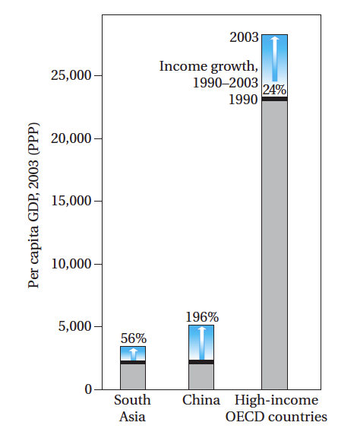

Slide 19
Consider now global inequality conceptualized as inequality across all citizens of the world, no matter where they live. Rank them from richest to poorest. What has happened to this inequality?
Think of this inequality as being made up of two components—within country inequality and between country inequality. We have been discussing these two components separately.
Within country inequality has gone up in some big countries, but gone down in others.
Between country inequality has gone down as poor countries have grown faster than rich countries.

Slide 20
What is the net result?
The global Gini coefficient fell from 72.2% in 1988 to 70.5% in 2008 (Lakner and Milanovic, 2016; similar calculations in Bourguignon, 2016 and Ravallion, 2018).
Formal mathematical decomposition methods show that the between group component of global inequality is very high, but it has fallen in the last three decades, pulling down total inequality despite an increase in the within country component.

Slide 21
These patterns of the evolution of inequality in the last three decades raise important questions which traverse the domains of operational policy and moral philosophy.
They do so in many different ways.
I would like to illustrate with two lines of discourse.
First, the question of development assistance to poor countries.
Second, global constraints on national policy to mitigate the forces making for rising inequality.

Slide 22
Implications for Development Assistance
We have seen how poor countries on average, driven in particular by some large poor countries, have grown much faster than rich countries. And they have grown fast enough to bring down overall global inequality despite the increase in inequality within these large poor countries.
Sumner (2012) presented an intriguing set of stylized facts which follow from these global distributional trends, but focusing on poverty, and using commonplace official classifications of Low Income Countries (LICs) and Middle Income Countries (MICs), and official definitions of poverty.
Using official international definitions and measures, the following statements hold true: (i) thirty years ago, 90% of the world’s poor lived in LICs; (ii) today, 75% of the world’s poor live in MICs.

Slide 23
The poor have not moved, of course! Rather, they have been reclassified.
What has happened is that the countries in which they lived have grown so fast, on average, that they are now citizens of MICs rather than LICs.
But the rising tide has not lifted all boats, at least not sufficiently, and this is associated with rising inequality in these large fast growing economies.
The result is that the bulk of the poor now live in countries that are not poor, at least according to the LIC/MIC criterion.

Slide 24
These stylized facts represent a growing disconnect between a person being poor and his or her country being poor.
Thirty years ago, the connection was quite tight. Not so much now.
This evolution has impacted significantly the debate on criteria for aid allocation, both in its practicalities and in its philosophical foundations.

Slide 25
On practicalities, almost all aid donors have thresholds and cutoffs for average income beyond which they begin to taper off aid to (the no longer so) poor countries.
The cutoffs vary from agency to agency but by and large they cluster around the LIC/MIC threshold, currently a gross national income per head of around $1,000.
For example, the cutoff for the World Bank’s soft loan arm IDA is $1,165 in 2018. If this “graduation rule” were to be maintained, as Moss and Leo (2011) have argued, in a few years the fund that was created to engage with the world’s poor would be disengaged with the bulk of them, who now live in MICs.

Slide 26
India was a case in point in 2013, when discussions started on its “graduation” because India had been above the cutoff at that time for three years in a row, which is the usual trigger for the start of phasing out.
The analytical argument in Kanbur and Sumner (2012), “Poor Countries or Poor People?” was that the focus of attention should be poor people, not poor countries. Now that the correlation between the two was falling apart, the IDA graduation rules should be revisited.

Slide 27
In India itself the debate was lively, between those who viewed it as a matter of national pride that India was about to graduate out of IDA, and those who felt that the additional concessional funds were need for addressing poverty.
In Northern countries a particular sticking point was that India was itself an aid donor to even poorer countries.
This raised the question, in the words of Kanbur (2015), “Can a Country Be a Donor and a Recipient of Aid?”

Slide 28
The debate was eventually resolved in favor of allowing India continued access to IDA for the next round of IDA, 2014-2016.
But this was recognized to be temporary, with the phase out beginning in the next three year round, 2017-2019.
Whatever the outcome and whatever the ongoing debate on IDA’s operational rules, the basic point is that the evolving patterns of global inequality are impinging on the development discourse significantly.

Slide 29
It turns out that the operational and political debates which the new patterns of global income distribution are giving rise to, also tie in to major philosophical debates on the salience of the nation state in moral philosophical evaluation of distributional outcomes.
Focusing solely on global inequality without attention to within nation inequality is often referred to as emerging from a “cosmopolitan” philosophical perspective, which does not give special salience to the nation state.
This would be the argument (as developed for example by Kanbur and Sumner, 2015) for continuing to give development assistance to India because it still has millions of poor people, even though the country on average has crossed the poverty line.

Slide 30
The argument of Rawls (1971), developing the principle of focusing policy on the poorest in society, is well known.
A group of philosophers labeled the “Global Rawlsians” simply globalized this principle (eg Beitz, 1979, Pogge, 1989, Singer, 2002).
On this view, aid should flow to the poorest no matter in which country they live, the nation state being irrelevant to this moral determination.

Slide 31
However, perhaps surprisingly, Rawls provided a counter to this in Rawls (1999). To quote Nagel (2005, pp. 114-115):
“Rawls argued that the liberal requirements of justice include a strong component of equality among citizens, but that this is a specifically political demand, which applies to the basic structure of a unified nation-state….Egalitarian justice is a requirement on the internal political, economic, and social structure of nation-states and cannot be extrapolated to different contexts.”

Slide 32
If one does give nation states special weight in assessment of inequality, that can change our views on the levels and trends of global inequality. But there are other aspects to assessing global inequality as well, each of which can give a different view on the trend of inequality:
“Global inequality is found to be rising if one or more of the following conditions holds: (i) one attaches a high ethical weight on the poorest; (ii) one has a strong ethical aversion to “high-end inequality;” (iii) one takes a more nationalistic perspective, emphasizing relative deprivation within countries; or (iv) one sees inequality as absolute rather than relative. “ (Ravallion, 2018, p. 1).

Slide 33
These issues were of course in principle relevant thirty years ago.
But it is the particular patterns of evolution of global inequality which have brought them to the forefront as philosophical questions, even as they impinge very directly on operational rules of aid agencies, and on the political economy of support for development assistance among the populations of rich countries.

Slide 34
Global Constraints on National Policy
As already argued, inequality is not rising everywhere and in the world as a whole.
But there is indeed a sense in which we are living in an age of rising inequality, going beyond the Piketty (2014) argument that rising inequality is the natural state of capital accumulation in a capitalist economy.
This is that the trend of technological progress is to displace basic labor in favor of skilled labor and capital. Such labor saving technical change, also called skill biased technical change has been the hallmark of the world economy for at least the last three decades, and looks set to continue in the decades to come (Autor, 2014; Acemoglu and Autor, 2011; Acemoglu and Restrepo 2018; Chau and Kanbur 2018).

Slide 35
If we accept the basic framework that labor saving technical change will, on a business as usual scenario, cause rising inequality over the politically relevant time horizon, what should be the policy response?
Kanbur (2018b) argues that responses fall into three broad categories.
First is a supply side response to counter the increase demand for skilled labor by increasing the supply of skilled labor through education policy. Indeed, this is argued to be part of the explanation for how Latin American countries bucked the trend and managed to reduce inequality over the past two decades.

Slide 36
The second canonical response is of course to redistribute the more unequal market income to achieve greater equality, through tax, transfer and expenditure instruments, and through labor market regulation.
There are of course huge debates on the details of this collection of instruments. The specific debates (eg on Universal Basic Income), important and crucial as they are, are not my primary focus in this talk.
Rather, as we shall see, I want to bring a global perspective on the constraints to national policies.

Slide 37
The third canonical response to labor saving technical change is a response that is largely absent from the literature. It arises as a response to the question—why must public policy take the trend of technical change as exogenous and not amenable to alteration through policy intervention?
Lest this be thought to be a Canute-like endeavor to push back the tide, let us remember that the technical change of today is what it is because of public investment in the past.
The internet is the product of public investment by the US government, albeit initially with military objectives. The high yielding varieties of rice and other grains developed in the 1950s and 1960s, which led to the Green Revolution and ended famine in India, were developed through public investment. The initial discoveries which led to the genetic modification revolution were incubated in the public sector.

Slide 38
The late Tony Atkinson (2015) took this view in his last book:
“The direction of technological change should be an explicit concern of policy-makers, encouraging innovation in a form that increases the employability of workers….” (Atkinson, 2015, pp 303)
Of course there will be many debates on how exactly this is to be done, and on whether it can be done at all. But the first step is to ask the question, a question which is missing from the current discourse.

Slide 39
The three national level responses to rising inequality outlined above can and will be debated.
But a prior question, perhaps, is how much freedom do national governments have to implement these policies in a globalized world where business and skilled labor are mobile across national borders.
This mobility may have contributed to narrowing income gaps between rich and poor countries, but it also constrains domestic policy to mitigate within country inequality.

Slide 40
Mobility of Capital means that corporate taxation, to manage rising inequality directly or to raise revenue for expanding education and training, is restricted in the absence of global agreements on minimum corporate tax rates.
In their absence, there will be a race to the bottom on these taxes.

Slide 41
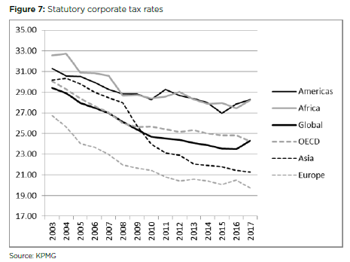

Slide 42
Mobility of skilled labor also means that taxation of high incomes from skilled labor is constrained in the same way that capital taxation is constrained.
Further, the efficacy of the supply side response to managing rising inequality, by increasing the supply of educated workers, is also dented if these can leave for lower tax pastures elsewhere.
A policy race to the bottom then follows.

Slide 43
Regulation and Labor Standards are a standard way of ensuring fairer distribution of the gains from technical change. To the extent that international trade and investment agreements restrict the scope of independent regulatory policy, there is less leeway for national governments.
But notice that even without these agreements there will be a race to the bottom as governments put in lower standards, or enforce standards less vigorously, to get a cost advantage in export markets. What is needed are minimum standards agreements across countries exporting into common markets.

Slide 44
Mobility of low income unskilled labor also raises issues for national management of inequality. If increased transfer benefits at the lower end, brought in to address displacement of basic labor, induce in-migration of basic labor, this will increase the fiscal costs of the redistribution policy.
This also applies to generalized subsidies such as food subsidies. If a transfer policy increases incentives for in-migration, the costs of that policy will be higher than anticipated. And if governments take these into account, there will be a race to the bottom on transfer policy as well.

Slide 45
Finally, consider incentivizing and public investment in R&D to shift the tide away from labor saving to labor using technical change, as proposed by Tony Atkinson (2015) in his last book.
But this faces all the problems of investment in public goods, since the benefits will spread beyond the borders of the initial investors. In this sense the global perspective once again highlights the tendency for under investment in inequality reducing interventions.

Slide 46
We are thus left with the conundrum that addressing national level inequality through national policies will be ineffective unless cross-national agreements can be reached on a range of tax and investment issues.
At the same time, however, we find that the global institutions we have are not fit for purpose, reflecting as they do the realities of three quarters of a century ago, of 1945 not 2020.
The weakness of global institutions in addressing these questions (Kanbur, 2017) is surely another sense in which we are living in an age of rising inequality.

Slide 47
Conclusion
In this talk I have approached income inequality from a global perspective.
The basic facts of global inequality are that inequality between nation states has been falling over the past three decades as poor countries like China and India have grown faster than rich countries like the US, Japan and Europe.
Inequality within nation states has risen overall, but is composed of a complex pattern of inequality rising in some countries but falling in others.
Policy has a large part to play in explaining these differences.

Slide 48
In the last three decades the decline in between-nation inequality has dominated the rise in within-nation inequality, so much so that overall world inequality has fallen.
This raises the question--which should be the dominant normative concern? To what extent can the decline in world inequality as a whole offset the increase in inequality within nations?
The answer depends on the salience of and weight given to the construct of the nation state.

Slide 49
I have highlighted a philosophical contest between those who apply Rawlsian principles to the global setting, versus Rawls himself, who argued that Rawlsian principles applied in effect to within the construct of the nation state.
These deep but seemingly esoteric normative debates have a practical import, impinging as they do on criteria for continuing aid to countries who continue to have many millions of poor people even though on average they have grown sufficiently to cross the threshold from low income to middle income status.

Slide 50
A framework for understanding policy responses within a country to rising inequality is to locate inequality in the consequences of labor saving technical change.
There are three canonical types of responses to such a technological trend. The first is to counter the demand side force by a supply side strategy of increasing the supply of skilled labor. The second is to redistribute income after the market forces have played through. The third, little discussed in the current discourse, is to invest in altering the course of technical change.
But each of these as a national policy option faces global constraints in a world in which business and labor is mobile across borders.
The need then is for global institutions which can help mitigate these cross-border externalities and thereby widen national policy space to address inequality.

Slide 51
Are we, then, living in an “Age of Rising Inequality?”
My answer is NO, BUT YES.
NO because inequality is not rising anywhere and everywhere. Policy can make a difference.
But YES for two important reasons.

Slide 52
First, the fundamental economic forces of capital accumulation and technical change are pulling towards rising inequality.
Second, policy makers’ freedom to address these forces faces global constraints, with no sign that the global institutions we have are helping to increase their policy space.
These are the twin senses in which one can say:
Yes, We Are Living in an Age of Rising Inequality.

Slide 53
Thank You!

